Slide 1


Step by Step Process to Submit Actual Investments Proofs
APJ- India Payroll

Slide 2
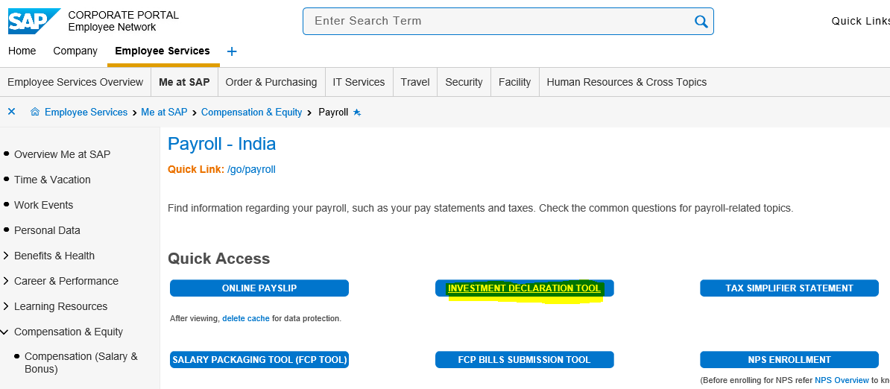
Investment Tool – Landing screen
1. Click on IT Tool/Click on the link provided in email communication

Slide 3
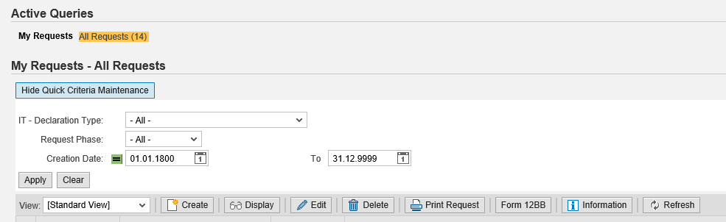
Investment Tool – Landing screen
2. Click on create

Slide 4
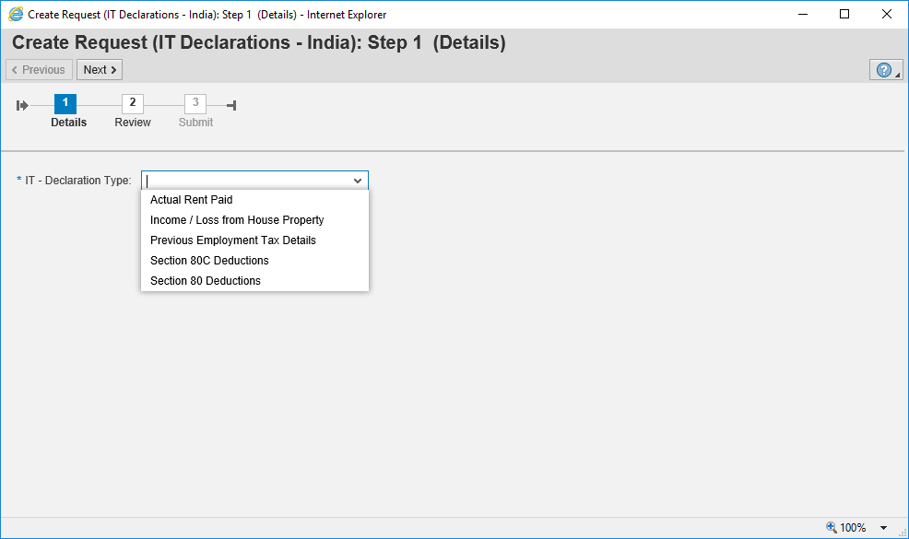
Process to submit Investment proofs
3. Click here to select option from drop down

Slide 5
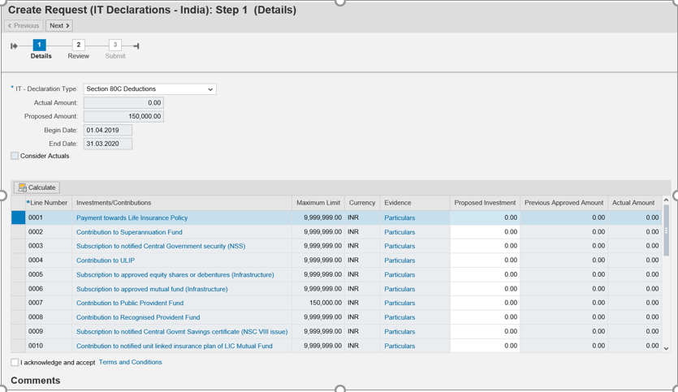
Process to submit Investment proofs
4. Enter amount in Actuals column against the type of investment proofs

Slide 6
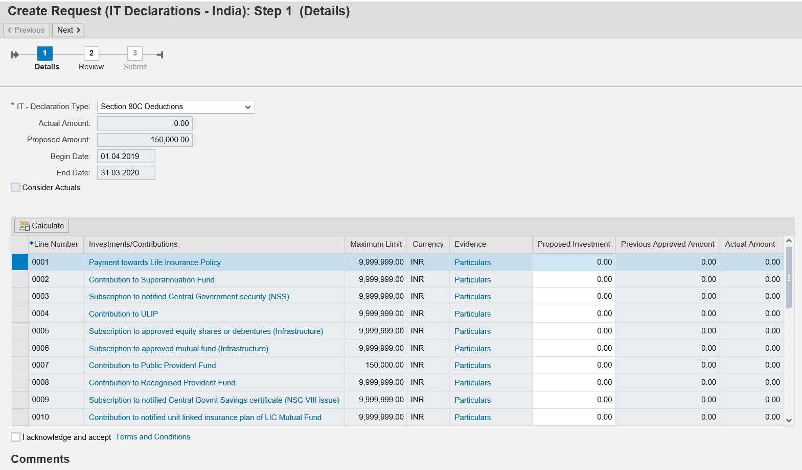
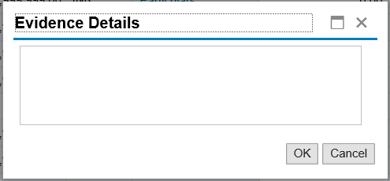
Process to submit Investment proofs
6. Enter policy/receipts numbers in this window and click ok
5. In the same screen click on particulars
7. Click on the check box

Slide 7
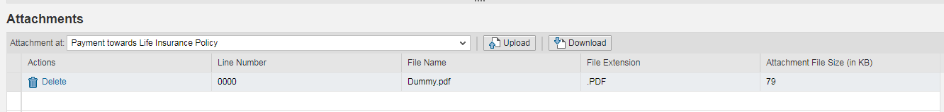
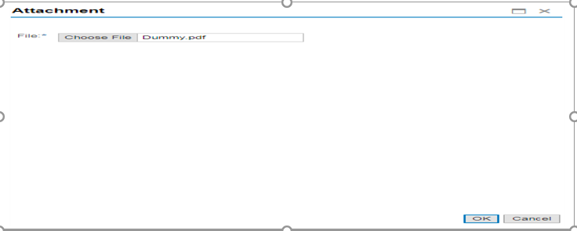
Process to submit Investment proofs
8. In the same screen scroll down and select the type of investment
9. Click on upload button, which will take you to browsing page
10. Click on choose file to select your PDF document

Slide 8
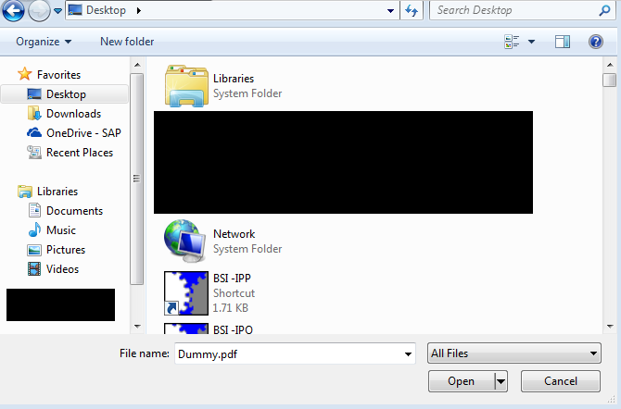
Process to submit Investment proofs
11. Select PDF document and click on open
12. Click on ok once you selected the PDF document

Slide 9
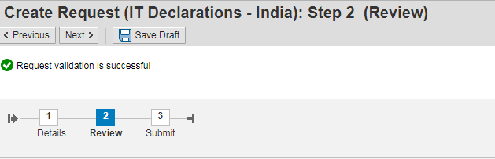
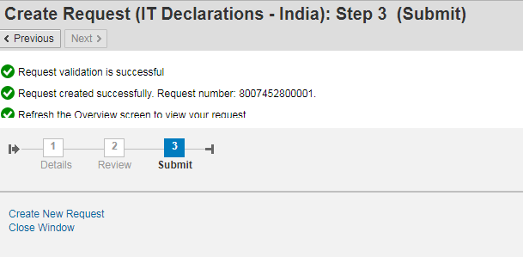
Process to submit Investment proofs
13. Click on next and finally click on submit button. DO NOT SAVE AS DRAFT
14. Once submitted ensure the request number created successfully

Slide 10
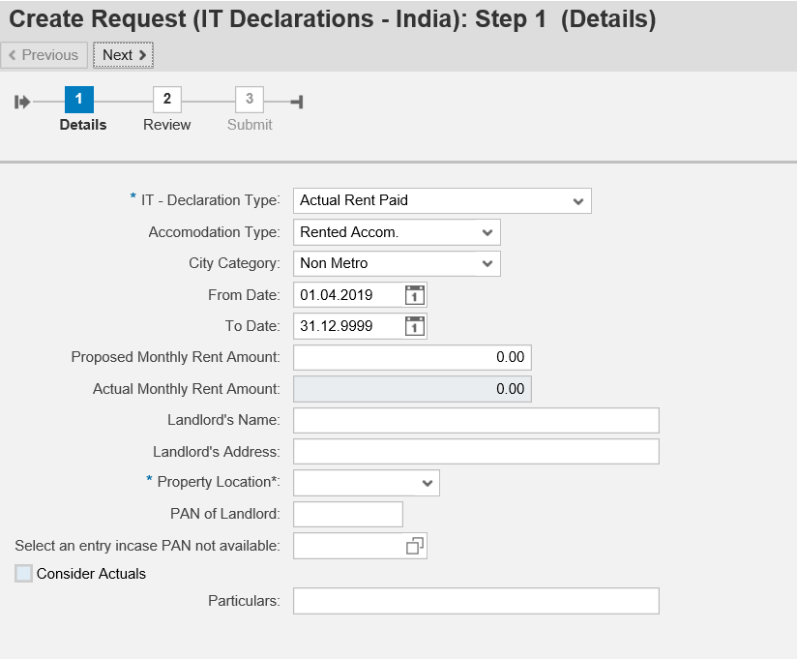
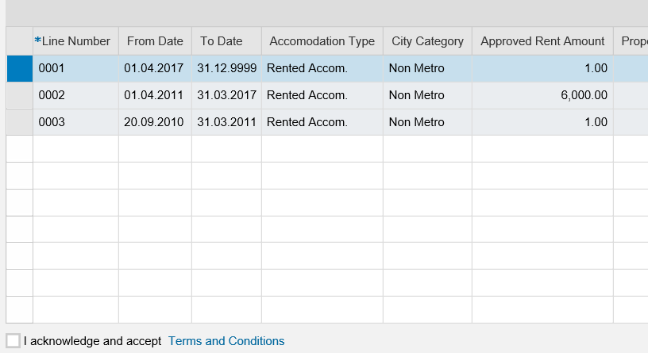
Process to update HRA details
Enter the details against each tab and note update monthly rent amount NOT ANNUAL
After updating the Rent and PAN number of landlord scroll down and tick on the check box

Slide 11
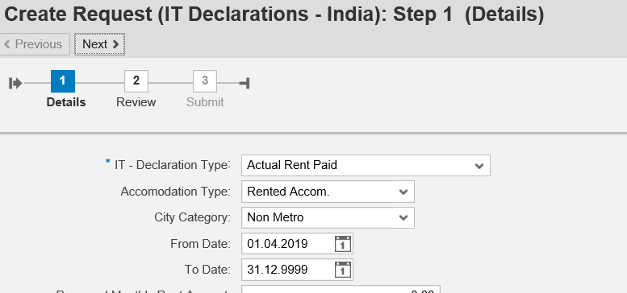
Process to update HRA details
Click on next until it gets submitted successfully. Do NOT SAVE AS DRAFT

Slide 12
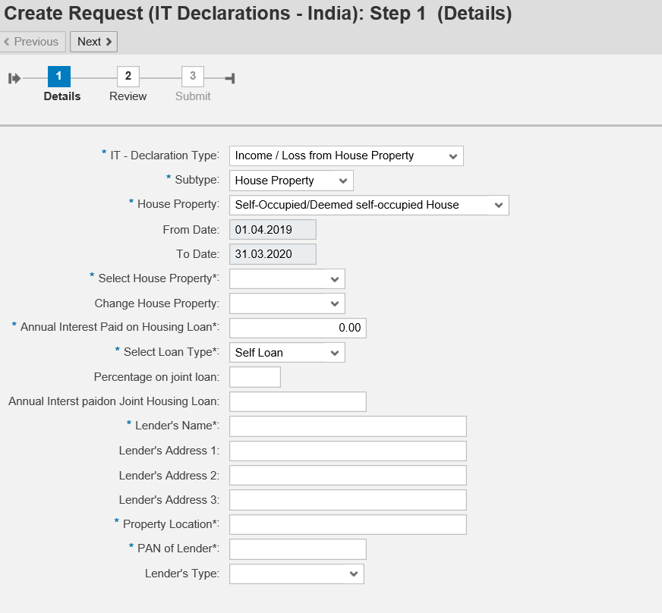
Process to update Income/Loss from House Property
Enter all the mandatory field against each tab
Interest will be calculated automatically based on the percentage declared
Enter percentage you would like to avail
Enter total interest amount as per your provisional bank certificate

Slide 13
Process to update Income/Loss from House Property
Follow the same process – In the same screen scroll down and select Income/Loss from house property
Click on upload button, which will take you to browsing page
Click on choose file to select your PDF document

Slide 14
Process to update Income/Loss from House Property
Select PDF document and click on open
Click on ok once you selected the PDF document

Slide 15
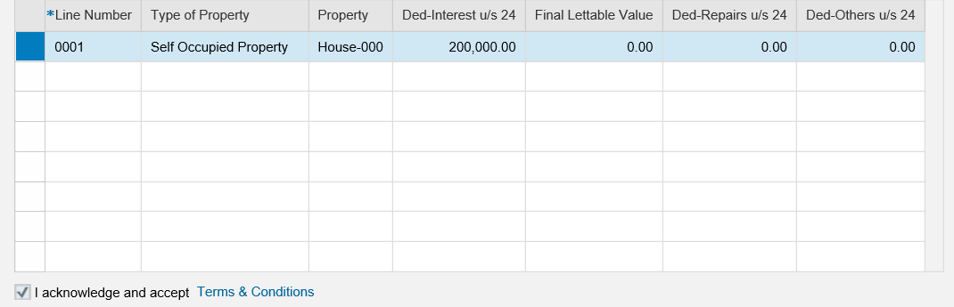
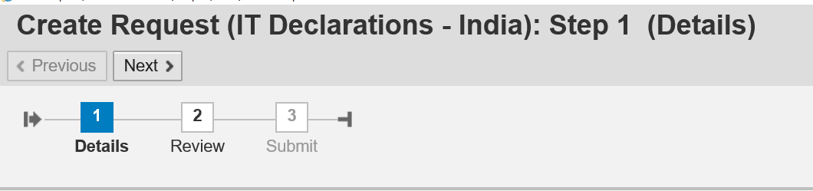
Process to update Income/Loss from House Property
Tick on this check box
Select next to proceed further
Click Submit once your declaration are reviewed to complete process
Click review once completely entered declaration

Slide 16
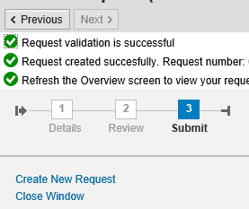
Process to update Income/Loss from House Property
Make Sure this message is displayed.

Slide 17
Thank You!
HRdirect ticket

